Slide 1

Quality Improvement Tool Templates
2024
©2024 American Cancer Society, Inc. All rights reserved.
Without limiting the copyright reserved above, no part of this publication may be reproduced without prior written consent of the American Cancer Society. For written permission, contact interventions@cancer.org.
6.11.24

Slide 2
Tool Templates
1
5
Form a Team
Process Map
2
Use Data
6
Identify Gaps
3
7
Set an Aim Statement
PDSA Cycles to Test Change
4
8
Action Plan
QI Storyboards

Slide 3

Form a Team

Slide 4
Identifying your Team
Participant | Roles and Responsibilities | Name(s)
Health System Leadership | Involved in cancer prioritization but generally not involved in day-to-day implementation efforts
Health System Core Team Clinical Champion (MD, DO, PA, NP) Clinical Champion (RN or MA) Quality Improvement Lead Information Technology Lead ACS Staff | Spend 5-10 hours each month on the project, including monthly meetings to carry out quality improvement and lead staff trainings. Responsibilities include: • Submit data • Create aim and action plan together • Carry out quality improvement methods • Execute evidence-based interventions • Coordinate staff trainings • Create clear communication methods to share plan and feedback with individual clinic sites • Participate in monthly meetings and contribute to agenda
ACS Staff | Support and participate in the core team as they carry out the planning and implementation of the program. • Serve as liaison between GHQ and health system partner • Review progress and financial reports • Stay abreast of report deadlines and other action items due • Provide guidance to partner on QI and EBI implementation • Identify opportunities for recognition and sustainability
Clinic Specific Champions | Represent their peers and culture (ex: 1 provider and 1 MA/RN). They should be involved in selecting interventions, designing the action plan and: • Disseminate and customize information • Implement quality improvement plan at their site • Assist with coordinating staff training • Motivate staff and advocate for importance of issue
All Health System Staff Includes providers, nurses, medical assistants and front desk (team that has day-to-day responsibility for serving target population) | Participate in trainings and customize action plan, as needed. Responsibilities include: • Contribute to understanding current state processes, share thoughts on gaps and opportunities for improvement • Work as a team to design/customize selected interventions • Implement interventions and review data

Slide 5
Using Data

Slide 6
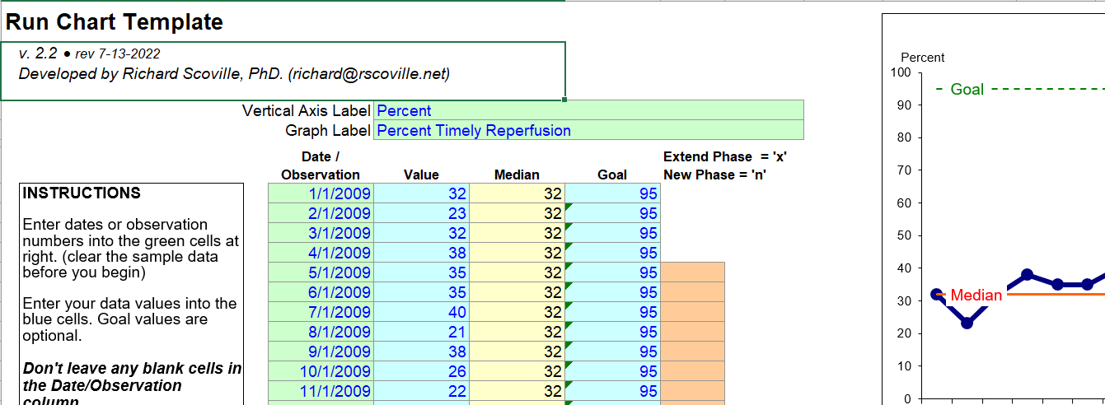
IHI Run Chart Template
The Microsoft Excel file provides a template to create run charts and consists of two worksheets:
  First tab allows you to enter data and creates a run chart as you enter data
  Second tab provides instructions on how to use a run chart to test for effective changes.
  Developed by IHI faculty Richard Scoville, PhD, and used in numerous IHI workshops and Collaboratives.

Slide 7
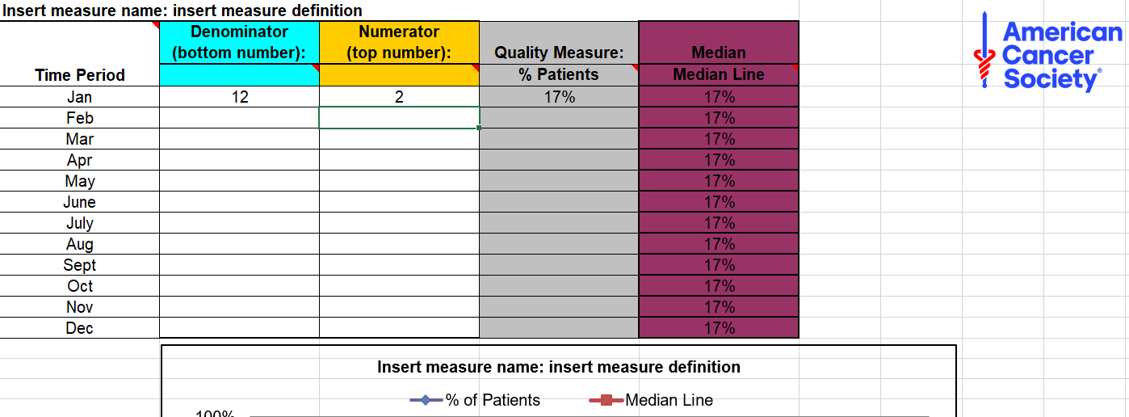
ACS Run Chart Template
The ACS Run Chart template can be found here.

Slide 8
Aim Statement

Slide 9
Creating a SMARTIE Aim Statement: Template 1
Specific
Measurable
Achievable
Realistic
Timely
Inclusive
Equitable
What do you want to do?
How will you know when you’ve reached it?
Is it in your power to accomplish it?
Can you realistically achieve it?
When exactly do you want to accomplish it?
Is it inclusive of the most impacted?
Does it promote health equity?
Type here…
Type here…
Type here…
Type here…
Type here…
Type here…
Type here…
Combine to Complete Aim Statement Here:

Slide 10
Creating your Aim Statement: Template 2
Aim Statement Worksheet
What? What’s the problem or opportunity? | Type here…
How much? By how much will you improve? Or “how good” do you want to get?
By when? What is the date by which you will achieve the level of improvement you’ve set out to accomplish?
For whom? Who is the customer or population who will benefit from the improvement?
Where? What are the boundaries of the process or system you’re trying to improve? Where does it begin and end?
Complete aim statement:

Slide 11
Action Planning

Slide 12
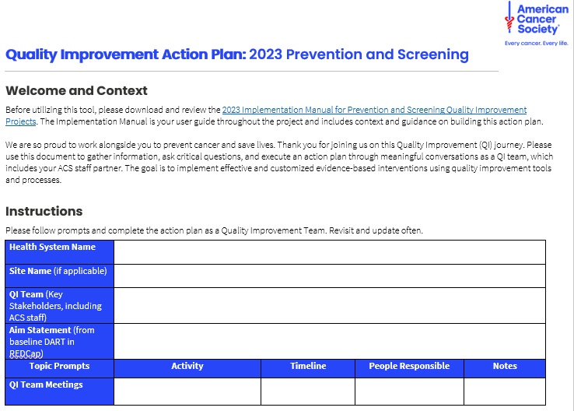
Creating your Action Plan: Template 1
Access Action Plan Word Worksheet here.

Slide 13
Creating your Action Plan: Template 2
Activity
Activity 1
Timeline
Date Due
Person Responsible
Name

Slide 14
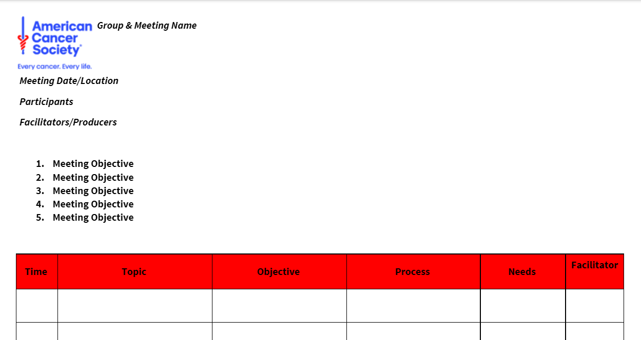
Agendas for Meaningful Meetings
Access Agenda Design Worksheet here.

Slide 15
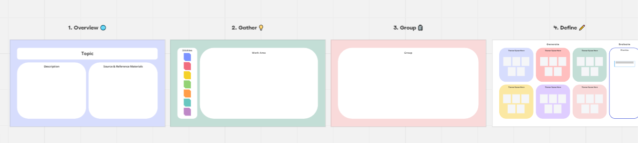
Affinity Diagramming Template
Affinity Diagramming is a QI tool that can be used to facilitate a brainstorming, grouping ideas and decision-making process as you create your action plan.
Miro Affinity Diagramming Template

Slide 16
Current and Future State Process Maps

Slide 17
General Format for Process Map
Pre-visit
Visit
Follow-up
Care Coordination
Care Coordination
Patient Engagement & Activation
Notes:
Click to share the 3 columns of a Process Mapping template.

Slide 18
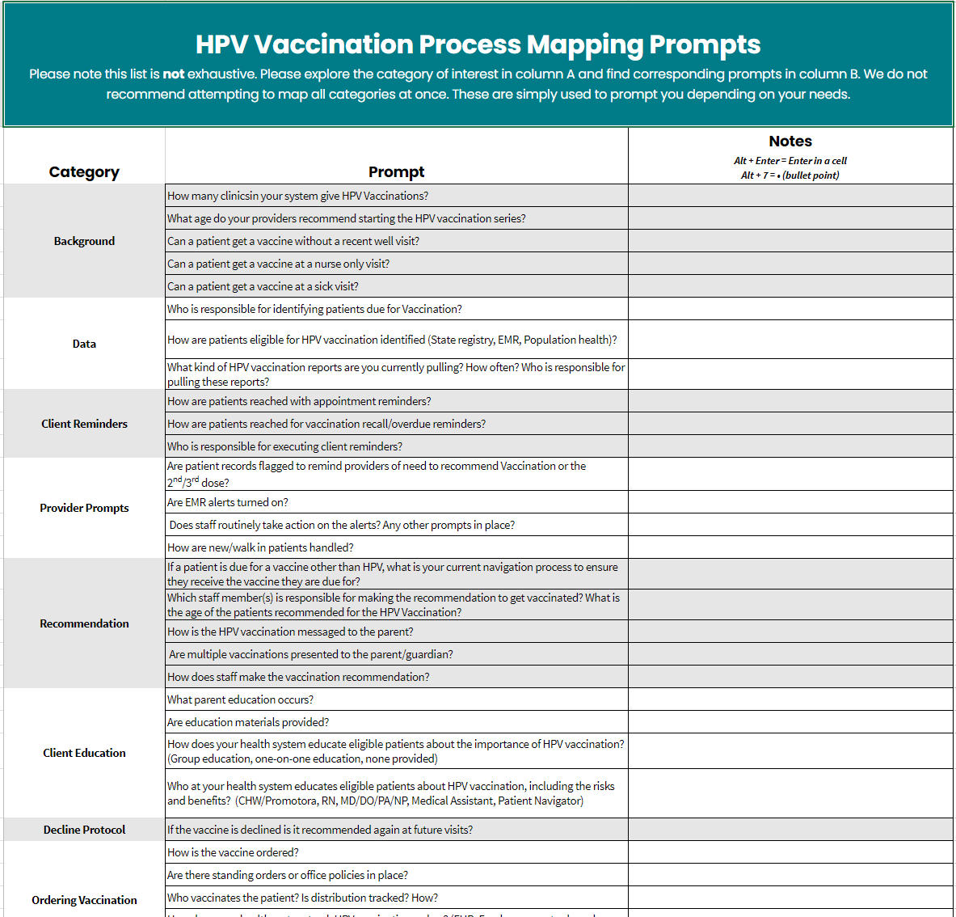
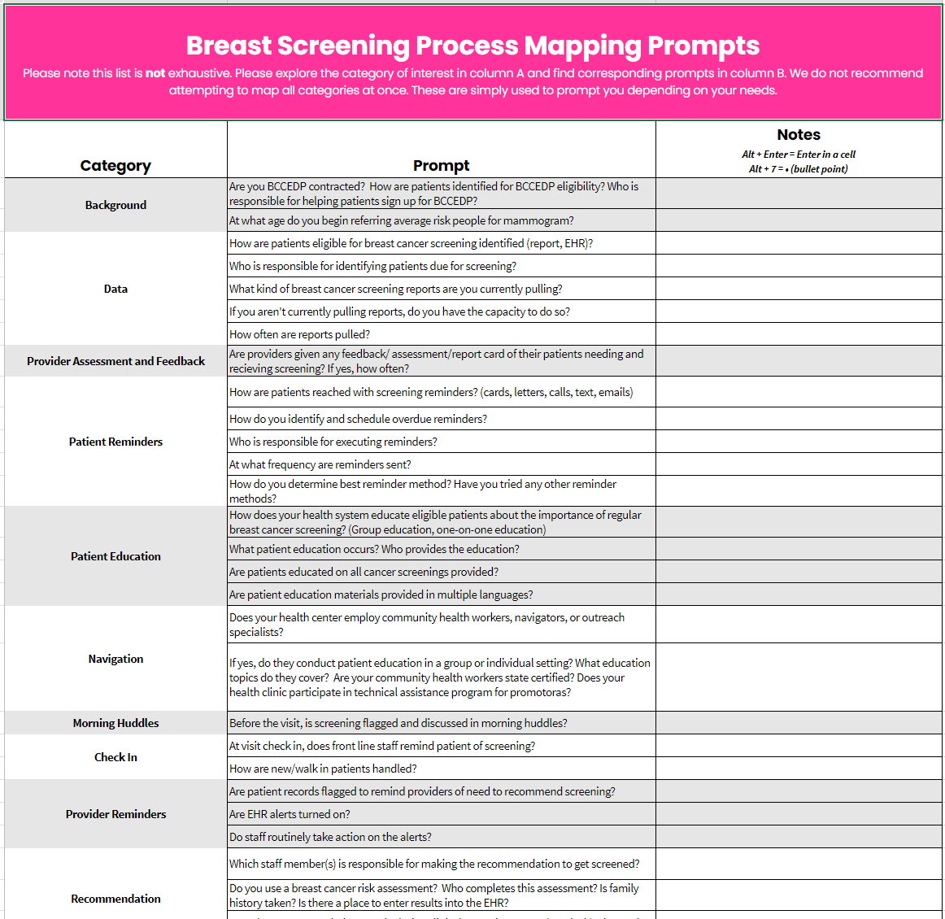
Process Mapping Question Prompts
Access excel file of questions to help populate create a process map here.
Resource includes four cancer screening types (breast, cervical, colorectal, and lung) and HPV vaccination
Notes:
Click to share the 3 columns of a Process Mapping template.

Slide 19
Process Map: Template 1
Pre-visit
Activity 1
Activity 2
Activity 3
Activity 4
Activity 5
Activity 6
Visit
Post Visit
Dream Board

Slide 20
Process Map: Template 2
Job Title
Activity 1
Activity 2
Activity 3
Activity 4
Activity 5
Job Title
Job Title
Job Title
Job Title
Dream Board:

Slide 21
Process Map: Template 3
Access Virtual Process Map Excel Worksheet here.
This has a tab for flowchart and tab for swimlane maps

Slide 22
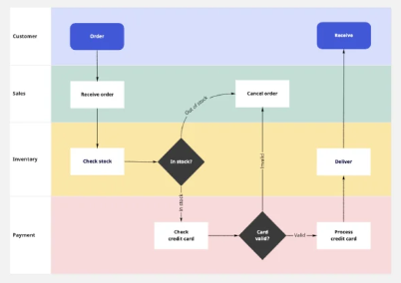
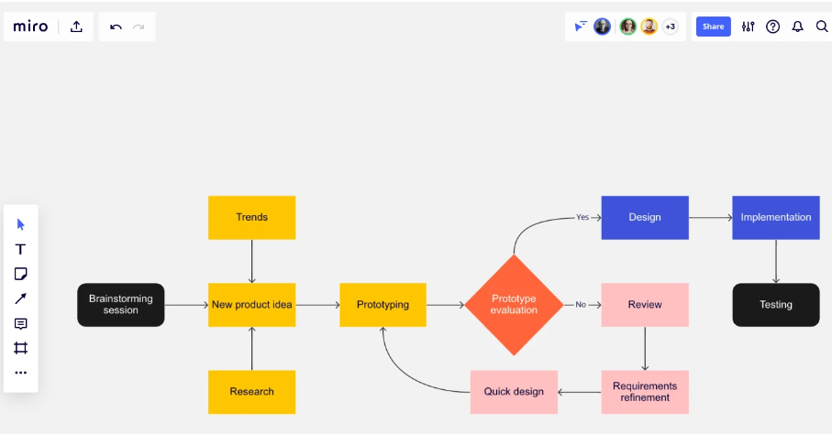
Process Map: Template 4
Miro is an online platform with free templates
Swimlane process map template here
Flowchart process map template here

Slide 23
Root Cause Analysis and Gap Analysis

Slide 24
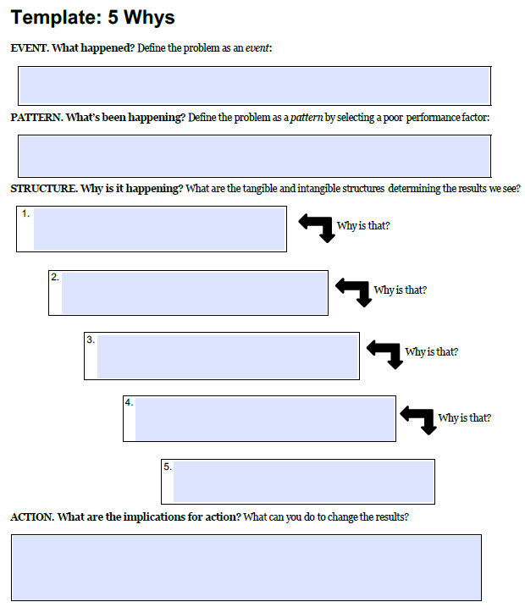
5 Why’s General Format
Notes:
Explain that both the 5 Why and Fishbone templates are in the participants worksheet and they have links to the folder on the Health Systems learning page containing the templates.

Slide 25
5 Why’s: Template 1
Problem (state as an event):
Why is that?
Why is that?
Type here…
Why is that?
Type here…
Why is that?
Type here…
Why is that?
Type here…
Type here…

Slide 26
5 Why’s: Template 2
Problem (state as an event)
Why is that?
Type here…
Why is that?
Type here…
Why is that?
Type here…
Why is that?
Why is that?
Type here…
Type here…

Slide 27
Fishbone Diagram: Template 1
People
Environment
Insert text
Insert text
Insert text
Insert text
Insert text
Insert text
Insert text
Insert text
Problem: Insert text
Insert text
Insert text
Insert text
Insert text
Insert text
Insert text
Insert text
Insert text
Insert text
Insert text
Insert text
Materials
Process
Equipment
Notes:
Confirm the problem-statement (placed in the “fish head”) and the categories (bones) that were mutually agreed upon in advance.
Ask for potential reasons for low rates and place them in the appropriate “fishbones.” Gather at least 3-4 causes and end the demonstration. Causes you may add include:
Parents fears of children’s pain (people).
Parents not scheduling the second dose (people or process).
Running out of vaccine doses (materials).

Slide 28
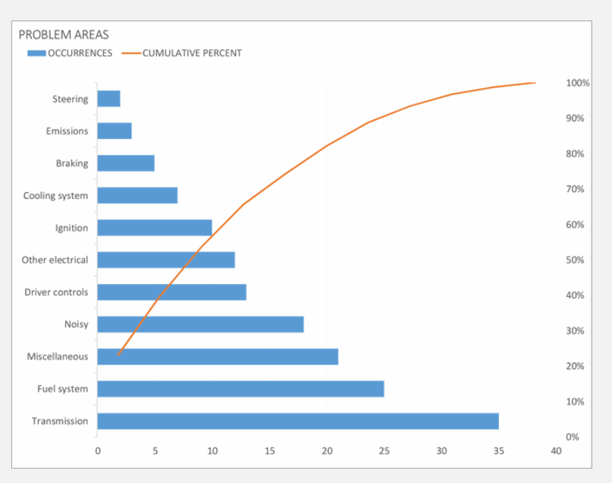
Pareto Diagram
Microsoft excel template of pareto diagram here
Input issues found into this problem analysis to show a visual representation of the problems in descending order

Slide 29
Plan Do Study Act Cycles (PDSA Cycles)

Slide 30
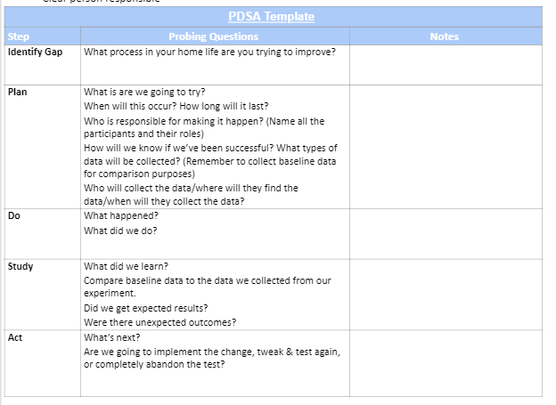
General PDSA Format
Notes:
Share this version of a PDSA template and relate it back to the pre-work at-home PDSA experiment that part
Review a few questions for each step of the PDSA

Slide 31
Plan Template – PDSA Cycles
Briefly describe the test
How will you know that the change is an improvement
What driver does the change impact
What you predict will happen
Plan for collection of data

Slide 32
Plan Template Continued – PDSA Cycles
For each activity listed on the previous slide, attach a timeline and person responsible
Activity | Timeline | Person Responsible
What are we going to try? | When will this occur? | Name and Role of person responsible for making it happen.

Slide 33
Do template– PDSA Cycles
Was the cycle carried out as planned?
What did you observe that was not part of our plan?

Slide 34
Study template– PDSA Cycles
Did the results march your predictions?
Yes or No
What do you see when you compare the results of your test to your previous performance?
What did you learn?

Slide 35
Act template– PDSA Cycles
Decide how to move forward with your test
Adopt: Select changes to implement on a large scale and develop an implementation plan for sustainability
Abandon: Discard this change idea and try a different one
Adapt: Improve the change and continue testing plan.

Slide 36
QI Storyboard

Slide 37


STORYBOARD
Your Name:
Health System Name:
Successes:
Enter
Examples
Here
Challenges:
Enter
Examples
Here
Next Steps:
Enter
Examples
Here
Find additional info in the notes section
Partnering with # clinics across
City/State.
Project Aim: Enter your brief goal
Project Activities:
Enter
Activities &
Interventions you did
QI Team:
Enter names of core team!
QI Tools used:
Collaborated with:
Enter your collaborators
Photo
Data
Health System Logo Here
Notes:
In order to highlight the great work and partnership between your system and American Cancer Society, please fill out as much of the above information as you have access to. Please feel free to edit the slide in order to highlight your project and share about your process and project specifics.
As you put this story together think about the following,
Who was on your team, what were their names?
What was the opportunity or obstacle you uncovered during your project?
What was the process like to overcome the obstacle or discover the opportunity?
What was the lesson you learned during the process?
What tools did you use to solve for the problem?
What was the result?

